Slide 1
RAG vs. GraphRAG: A Systematic Evaluation and Key Insights
Group 8
113524012 胡 禎
113524013 張祐豪
113524020 洪慈徽
113524025 郁宸瑋

Slide 2
Let me introduce Retrieval-Augmented Generation (RAG) first
RAG retrieves external knowledge to help LLMs make better decisions. It addresses hallucination, context window limits, and boosts factual accuracy. RAG mainly works with text-based data via lexical or semantic search.
What does RAG solve?
Helps in healthcare, law, finance, and education.
Enhances LLMs by reducing hallucination and improving robustness.
It’s a widely adopted, reliable technique.
Notes:
Cited from the paper:
"Retrieval-Augmented Generation (RAG) has emerged as a powerful approach to enhance downstream tasks by retrieving relevant knowledge from external data sources." (Section 1 Introduction)
"In most existing RAG systems, retrieval is primarily conducted from text databases using lexical and semantic search." (Section 1 Introduction)
"It has achieved remarkable success in various real-world applications, such as healthcare...law...finance...education..." (Section 1 Introduction)
"...significantly improves their faithfulness by mitigating hallucinations, reducing privacy risks, and enhancing robustness." (Section 1 Introduction)

Slide 3
Second, let’s go forward to
Graph Retrieval-Augmented Generation (GraphRAG)
GraphRAG retrieves from graph-structured data like knowledge graphs or molecule graphs. It captures relationships between entities, which is great for reasoning. Now it's even being used on text—by structuring text into graphs.
GraphRAG is evolving
Originally used existing graphs (e.g., KG), but now builds graphs from text itself.
Enables applications like summarization, planning, and reasoning.
It’s no longer just for structured data.
Notes:
Cited from the paper:
"GraphRAG has recently gained attention for retrieving graph-structured data, such as knowledge graphs (KGs) and molecular graphs." (Section 1 Introduction)
"GraphRAG has also demonstrated its effectiveness for text-based tasks after structuring implicit knowledge from text into graph representations." (Section 1 Introduction)
"Beyond leveraging existing graphs, GraphRAG has also demonstrated its effectiveness for text-based tasks after structuring implicit knowledge from text into graph representations..." (Section 1 Introduction)
"These studies highlight the potential of GraphRAG in processing text-based tasks by constructing graphs from textual data." (Section 2.2)

Slide 4
Third, what do we learn from this paper?
Most studies on GraphRAG are limited to specific tasks and datasets.
There's no systematic comparison between RAG and GraphRAG on general text tasks.
This study fills that gap by comparing them on QA and summarization benchmarks.
Independent variable: The method of retrieval (RAG vs GraphRAG)
Dependent variable: Performance in QA and summarization tasks
Both single-hop/multi-hop and single-/multi-document settings were tested.
Notes:
Cited from the paper:
"Most applications of GraphRAG for text data have been designed for specific tasks and datasets, lacking a systematic evaluation and comparison..." (Abstract)
"To bridge this gap, we systematically evaluate the performance of RAG and GraphRAG on general text-based tasks using widely adopted datasets..." (Section 1 Introduction)
"...we conduct experiments on both single-hop and multi-hop QA under single-document and multi-document scenarios." (Section 1 Introduction)
"...we evaluate both single-document and multi-document summarization to comprehensively assess the effectiveness of RAG and GraphRAG." (Section 1 Introduction)

Slide 5
Takeaway & Hook
RAG is better at detailed, fact-based tasks
(like single-hop QA).
GraphRAG excels at reasoning and multi-hop queries.
They are complementary, not competitors.
Two hybrid strategies: (1) Selection (2) Integration
Notes:
"Our findings reveal that RAG and GraphRAG are complementary, each excelling in different aspects." (Section 1 Introduction)
"We propose two strategies... (1) Selection... (2) Integration..." (Section 1 Introduction)
"For the Question Answering task, we observe that RAG performs better on single-hop questions and those requiring detailed information, while GraphRAG is more effective for multi-hop questions."
(Section 1 Introduction)
"In the Query-based Summarization task, RAG captures fine-grained details, whereas GraphRAG generates more diverse and multi-faceted summaries."
(Section 1 Introduction)

Slide 6
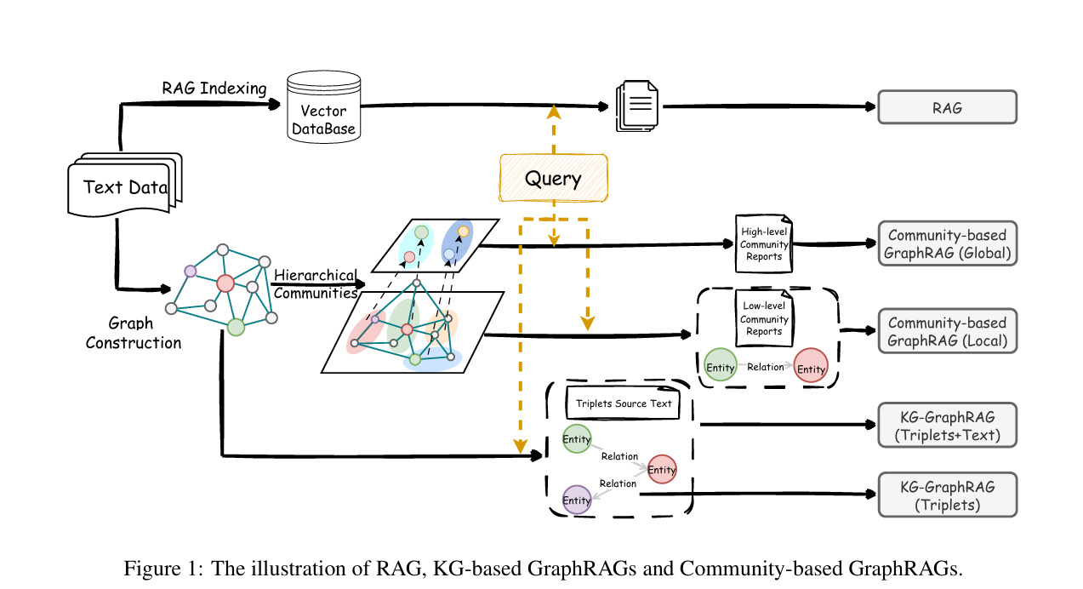

Slide 7
RAG Setup
Chunking Strategy: Input texts are split into smaller units (chunks) of about 256 tokens each.
Embedding Model: They use OpenAI’s text-embedding-ada-002 model for creating vector representations, known for its performance across retrieval tasks.
Retrieval Mechanism: For any given query, the top 10 most similar chunks are retrieved based on vector similarity.
Generation Models: Two versions of Llama 3.1 models are used for generating final answers:
Llama-3.1-8B-Instruct
Llama-3.1-70B-Instruct​.
Document Scope:
Single-Document Tasks: A separate RAG system is built for each document individually.
Multi-Document Tasks: All documents are indexed together into a single system.

Slide 8
GraphRAG Setup
KG-based GraphRAG (Knowledge Graph Extraction)
Graph Construction: Text chunks are processed with LLMs to extract triplets (head entity, relation, tail entity), building a Knowledge Graph (KG).
Retrieval:
Entities in the query are matched to entities in the KG.
From these matched nodes, a graph traversal retrieves relevant triplets and optionally the corresponding original text.
Two Variants:
KG-GraphRAG (Triplets): Only triplets are retrieved.
KG-GraphRAG (Triplets+Text): Both triplets and related source text are retrieved.
Implementation Tool: Built using the LlamaIndex toolkit​.

Slide 9
GraphRAG Setup
Community-based GraphRAG (Hierarchical Community Graphs)
Extended Graph Building: Beyond just a KG, this method organizes entities and relations into hierarchical communities using graph community detection algorithms.
Retrieval Strategies:
Local Search: Retrieves lower-level community information plus related entities and relations (rich in detailed content)
Global Search: Focuses on retrieving higher-level summaries for a more abstract and general retrieval.
Implementation Tool: Implemented with Microsoft’s GraphRAG framework​.

Slide 10
Question Answering
One of the most widely used tasks for evaluating the performance of RAG systems.
single-hop QA, multi-hop QA, and open-domain QA (Wang, 2022)
Data sets and Evaluation Metrics
Dataset | TaskType | Description
Natural Questions (NQ) (Kwiatkowski et al., 2019) | Single-hop QA | Real-world factual questions collected from Google Search. Questions are short and direct; e.g., Where is the capital of China?
HotpotQA (Yang et al., 2018) | Multi-hop QA | Requires reasoning across two or more passages, e.g., combining information from A and B to derive answer C.
MultiHop-RAG (Tang and Yang, 2024) | Multi-hop QA | Involving multiple documents and multi-step reasoning. Questions are categorized into: Inference, Comparison, Temporal, and Null types.
NovelQA (Tang and Yang, 2024) | Single-hop + Multi-hop QA | Based on full-length English novels (>50,000 words). Questions are involving narrative reasoning, character relationships, etc.

Slide 11
QA Main Results
Evaluation metrics
Category | Reason/Explanation
NQ / HotpotQA uses Precision, Recall, F1-score | The answers are usually a short sentence or a short phrase, it is necessary to evaluate both whether the predicted answer exists (Precision) and whether all correct answers were included (Recall).
MultiHop-RAG / NovelQA uses Accuracy | The questions are classification-based(The answers are discrete choices), e.g., selecting the correct option through inference, or judging whether an answer exists.

Slide 12
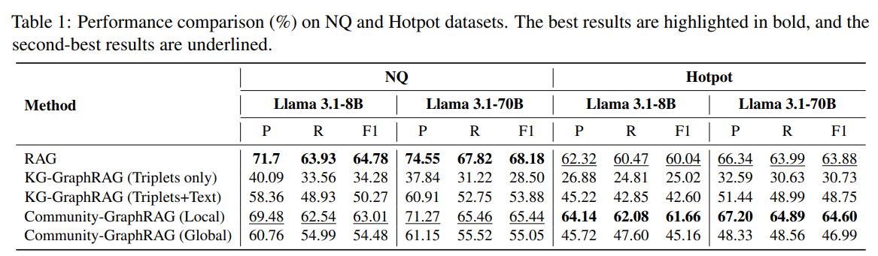
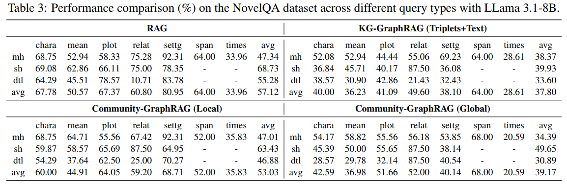
QA Main Results
RAG performs well on single-hop questions and those requiring detailed information.
Notes:
RAG performs well on single-hop questions and those requiring detailed information. This is validated by its performance on the NQ dataset as well as the single-hop (sh) and detail-oriented (dtl) questions in the NovelQA dataset (Table 1 and Table 3).

Slide 13
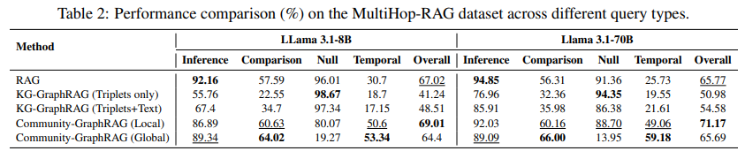
QA Main Results
GraphRAG excels on multi-hop queries. For instance, it achieved the best performance on both the HotPotQA and MultiHop-RAG datasets.
Notes:
GraphRAG, particularly Community-GraphRAG (Local), excels on multi-hop queries. For instance, it achieved the best performance on both the HotPotQA and MultiHop-RAG datasets. Although its overall performance on the NovelQA dataset is lower than that of RAG, it still performs well on the multi-hop (mh) queries in NovelQA.

Slide 14
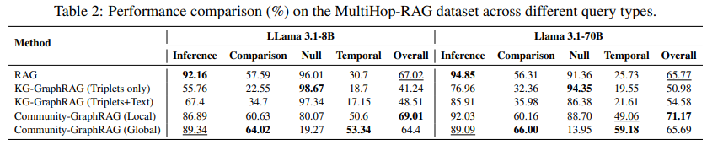
QA Main Results
Community-GraphRAG (Global) lacks detail and is prone to hallucinations, performing especially poorly on detailed and null-type QA questions.

Slide 15
QA Main Results
KG-based GraphRAG performs poorly in QA tasks mainly because the knowledge graphs constructed from text are incomplete. Only around 65% of answer entities in Hotpot and NQ datasets are present in the constructed graphs.

Slide 16
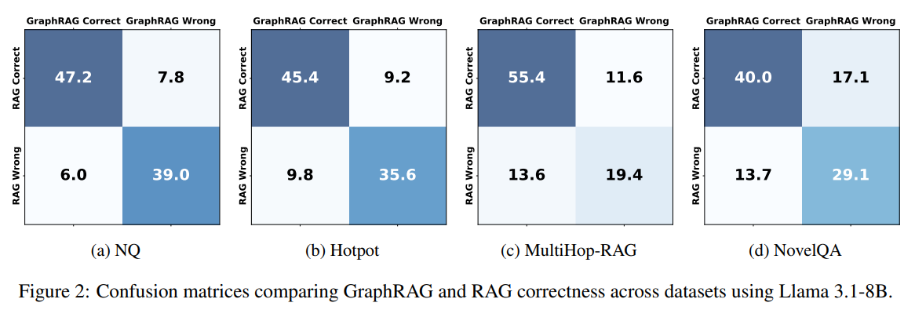
Comparative QA Analysis
Queries answered
Correctly by both methods、correctly only by RAG (RAG-only)、correctly only by GraphRAG (GraphRAG-only), and incorrectly by both methods.

Slide 17
Improving QA Performance
Building on the complementary properties of RAG and GraphRAG, we investigate the following two strategies to enhance overall QA performance.
Strategy 1: RAG vs. GraphRAG Selection.
RAG is well-suited for fact-based questions that require direct retrieval and detailed information.
GraphRAG (Local) is more effective for reasoning-based questions that involve multi-step inference.
Strategy 2: RAG vs. GraphRAG Integration.
The retrieved contents from both RAG and GraphRAG are concatenated and jointly input into the generator to produce the final response.
Maximally combines the advantages of both methods, but comes with higher computational cost.
On the MultiHop-RAG dataset using the Llama 3.1-70B model, both strategies effectively improved performance. The Selection strategy outperformed the best individual model by 1.1%, while the Integration strategy achieved a 6.4% improvement.

Slide 18
Query-Based Summarization
A widely used task to evaluate the performance of RAG systems.
Prior work focused mainly on global summarization (Edge et al., 2024).
Lacking: Evaluation of RAG and GraphRAG for Query-Based Summarization.
Datasets and Evaluation Metrics
Datasets: SQuALITY(Wang et al., 2022), QMSum (Zhong et al., 2021), ODSum-story, ODSum-meeting (Zhou et al., 2023).
Metrics: ROUGE-2 (Lin, 2004), BERTScore (Zhang et al., 2019).

Slide 19
Datasets
Catogory | Dataset | Description
Single-document | SQuALITY (Wang et al., 2022) | Short stories from Project Gutenberg. Each query has 4 human-written summaries.
 | QMSum (Zhong et al., 2021) | Annotated queries and summaries from multi-domain meetings.
Multi-document | ODSum-story (Zhou et al., 2023) | Multi-doc version of SQuALITY for open-domain story summarization.
 | ODSum-meeting (Zhou et al., 2023) | Multi-doc version of QMSum for meeting summarization across multiple files.

Slide 20
Evaluation Metrics
Measuring lexical and semantic similarity between the predicted and ground truth summaries.
Metrics | Reason / Explanation
ROUGE-2 (Lin, 2004) | Measures lexical overlap at the bigram level between generated and reference summaries. It captures surface-level accuracy, useful for evaluating content preservation.
BERTScore (Zhang et al., 2019) | Uses pre-trained BERT embeddings to compute semantic similarity between generated and reference summaries. It captures deeper meaning alignment and paraphrasing quality.

Slide 21
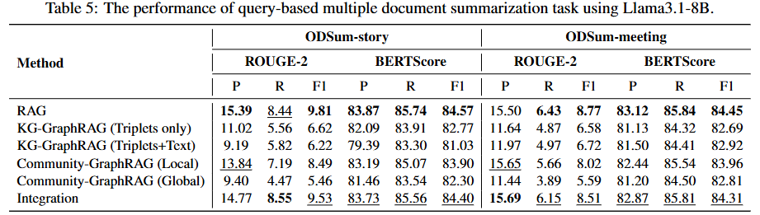
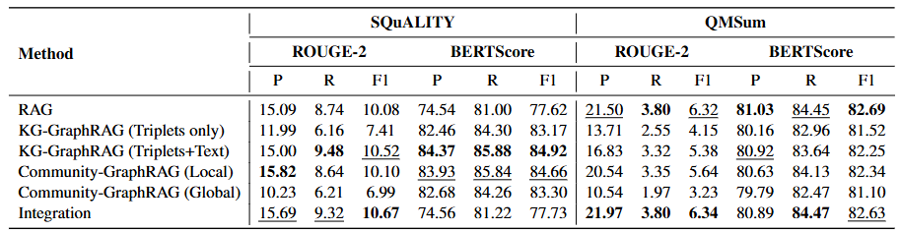
Summarization Experimental Results
RAG generally performs well on query-based summarization tasks.
Especially on the multi-document summarization tasks.
RAG is often the best method.

Slide 22
Summarization Experimental Results
KG-based GraphRAG benefit from combining triplets with their corresponding text.
By obtaining more details from text, its predictions are closer to the ground truth.

Slide 23
Summarization Experimental Results
Community-based GraphRAG performs better with the Local search method.
Local search retrieves low-level details, entities which leads to more accurate and informative summaries compared to global search.

Slide 24
Summarization Experimental Results
The Integration strategy is often comparable to RAG only performance.
Combining RAG with GraphRAG-Local yields performance similar to using RAG alone.

Slide 25
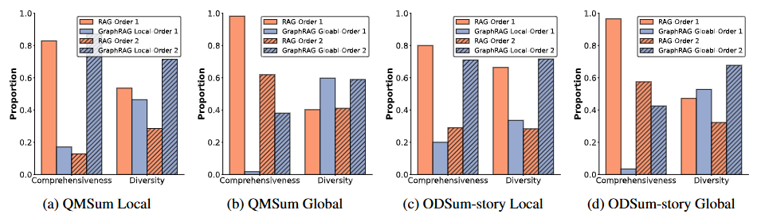
Position Bias in Existing Evaluation
Community-based GraphRAG underperforms compared to RAG. It’s contrasts with previous research(Edge et al, 2024).
Key differences: Focuing on global summarization, LLM-as-a-Judge.
Position Bias existing in LLM-as-a-Judge
Changing the order of the two methods will significantly affect result fairness.
Community-based GraphRAG(Global) focuses more on the global aspects of whole corpus, whereas RAG captures more detailed information.

Slide 26
Conclusion
Systematically evaluate and compare RAG and GraphRAG on general text-based tasks.
RAG performs strongly across both QA and summarization, especially in detail-focused queries.
GraphRAG (Local) shows advantages in reasoning and diverse content coverage, particularly when local graph structure is used.
GraphRAG (Global) often underperforms due to loss of contextual grounding and over-generalization.
Integration strategies combine both models, but results are comparable to RAG alone in most tasks.

Slide 27
Conclusion
Evaluating AI systems with LLMs requires bias-aware and balanced designs.
This study reveals the distinct strengths of RAG and GraphRAG, providing valuable insights for future research.
Future Work:
Broaden task types, model selection.
Improving graph construction to improve GraphRAG or developing novel approaches to combine RAG and GraphRAG to get better perfomence.

Slide 28
Thank you

